Slide 1
Strings in Python Programming
By:
Learn Python

Slide 2
Strings in Python
Creating a string
String slicing
In clause in set
Loops in Set
Length
adding string

Slide 3
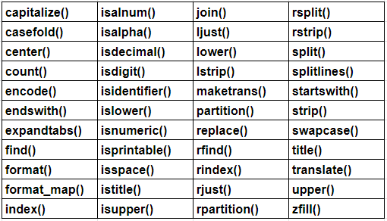
String specific methods

Slide 4
Thank You

